Slide 1


Enhancing Runtime Monitors of Cyber-Physical Systems using Negative Selection
João Paulo Araujo
20/0099663
Notes:
First of all, thank you for being here and for taking time to read my work.
The approach we’re going to cover today verses about Enhancing runtime monitors of cyber-physical systems using the Negative Selection Algorithm

Slide 2
Summary
Introduction
Background
Running Example: BSN
Methodology
Related Work
Evaluation
Conclusion
Notes:
Here we have a brief summary of what we’re going to cover, which follows the sections of the document you’ve read.

Slide 3

introduction
Notes:
First, we will introduce our work by presenting the motivation behind it.

Slide 4
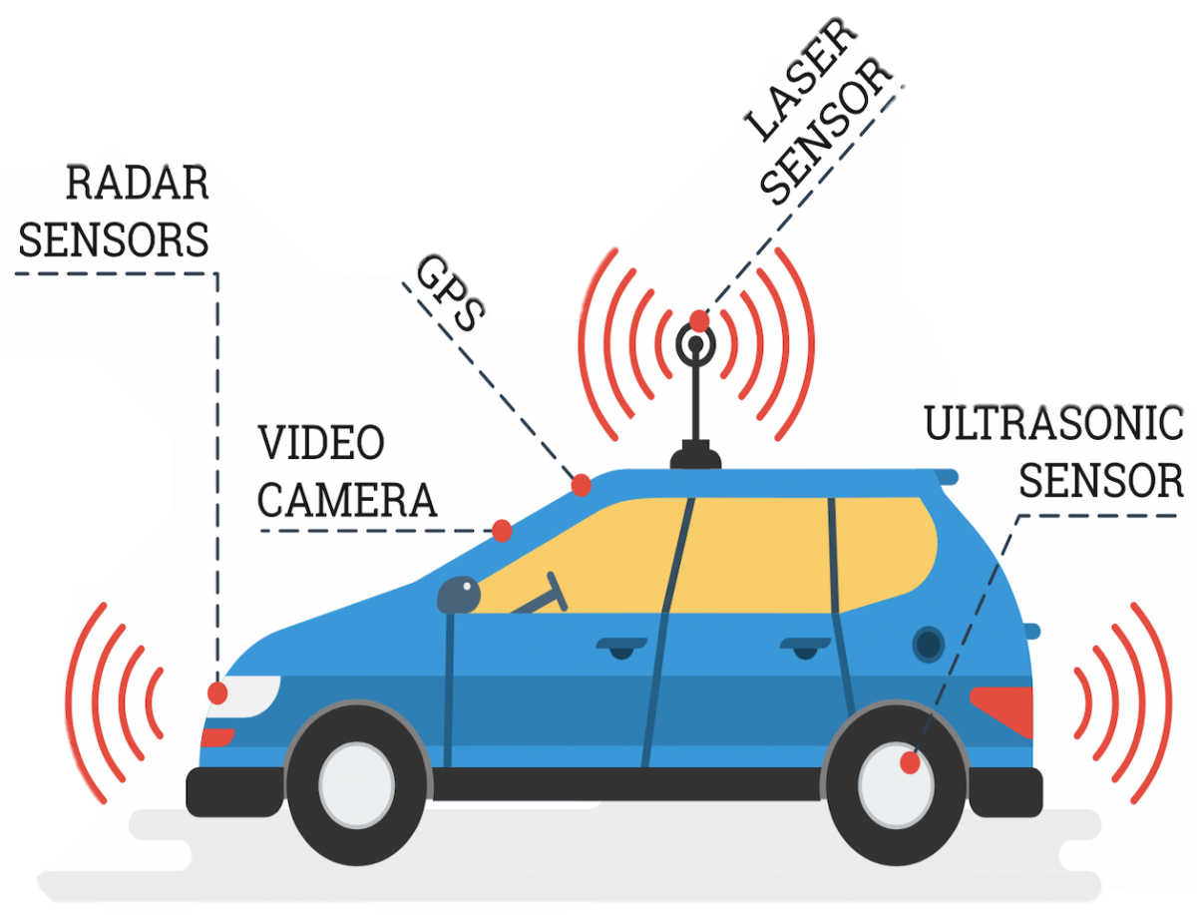
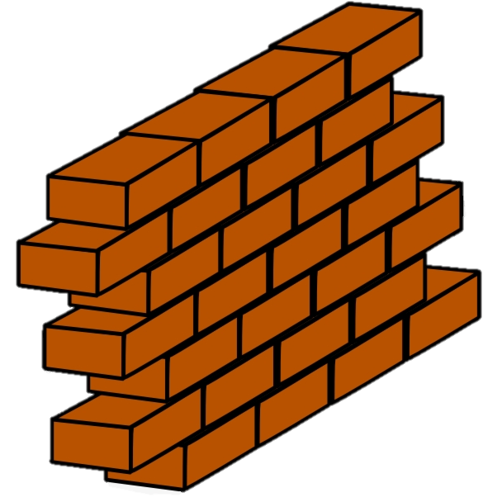
Motivation
Assurances are needed to guarantee the correct execution!
?
Almost impossible to anticipate the all the different scenarios
Cyber-physical System (CPS)
Notes:
(PASS)
Cyber-physical systems are systems that integrate physical processes with software components.
(PASS)
A very good example is an autonomous car, which has a set of sensors, cameras, GPS and so on,
All connected to a software responsible for deciding which actions to make.
(PASS)
However, before we can take our car out in the streets, we need to make sure that the system works as expected
For instance,
(PASS)
If we find an obstacle, we need to make sure that the car will stop within a reasonable time, for the sake of the passengers.
(PASS)
Nevertheless, it might be a fixed obstacle, like this wall, or a moving one, like running child or a dog
The street may also be wet because of the rain, and some of the tire’s screws may be loose.
(PASS)
Hence, it’s nearly impossible to anticipate all the different scenarios that may happen to harm the fulfilment of the CPS’s requirements.

Slide 5

Motivation – runtime verification
TURN_ON
TURN_OFF
$$¬φ→∅$$
TURN_OFF
TURN_ON
Property
Observer
TURN_OFF
ON_REACHED
~OFF_HOLDS
PROCESSSED_REACHED
OFF_REACHED
OFF_HOLDS
DETECTED_REACHED
OFF_REACHED
Notes:
One of the ways that these guarantees can be provided is through runtime verification.
It is a procedure that relies on gathering data from a running system to determine whether specific properties are being satisfied.
(PASS)
This can be achieved by runtime monitors, also called Observers, which are derived from a set of formal properties that specifies what the system should and should not do.
(PASS)
(PASS)
These observers can listen to the signals sent throughout the system in order to transition between states and are implemented in a way that an error state is reached whenever the respective property is violated.
When that happens, the system can alert the user, or run some predefined process in order to maintain the regular operation.
Afterwards, the analyst can take a closer look and perform the proper correction measures.

Slide 6
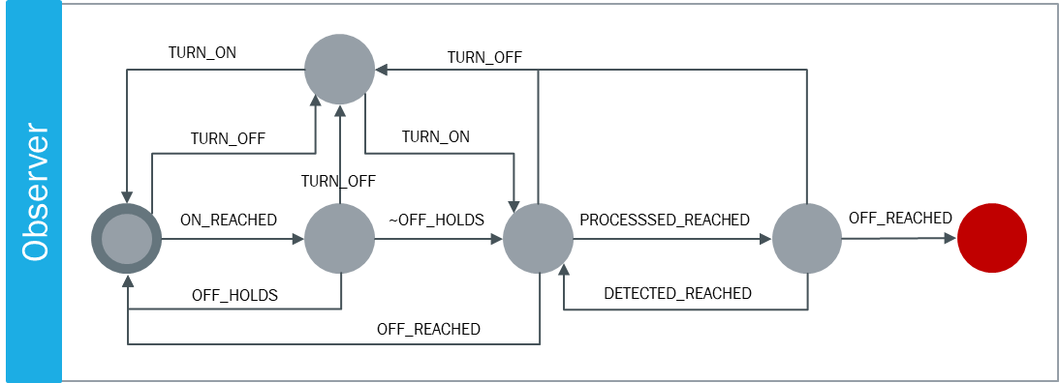

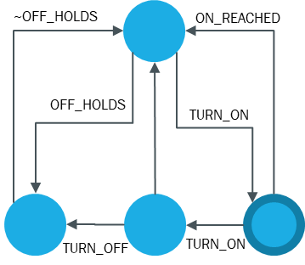



Motivation – runtime verification
Problems raised in literature:
System Model
Monitoring is costly
$$¬φ→∅$$
Not all scenarios might be covered by the observer
Property
Notes:
So that we don’t have to implement the CPS and wait for the error to happen, a prototype is usually created before the system’s deployment, so that several simulations are executed.
(PASS)
For that, a model of the system and the set of properties are the input (PASS) for the creation (PASS) of the prototype, which also counts on (PASS) the implementation of the runtime monitors for its verification.
The simulations are executed with varying configurations to account for the different scenarios that may happen in runtime.
For example,
(PASS)
We may simulate a failure of a component, or
(PASS)
Some physical process that may impact on the CPS’s behavior or
(PASS)
Some crash in the system.
In those cases (PASS)
How would the monitors behave?
Would they provide meaningful alerts to the user?
Will the analyst be able to understand why the violation happened?
We could increase the amount of monitors, but the literature shows that this might increase the cost of observing the system.
Besides, not all scenarios might be covered.
(PASS)

Slide 7
Research Question
How to enhance runtime monitors accurately and systematically to account for the complex interaction between the physical and cybernetic nature of CPS?
Notes:
This raises the following question:
(PASS)
How to enhance runtime monitors accurately and systematically to account for the complex interaction between the physical and cybernetic nature of CPS?

Slide 8


Motivation
Notes:
As science usually does
(PASS)
We sought inspiration in nature to answer this question
(PASS)

Slide 9
Motivation
Notes:
There’s a research area called Artificial Immune Systems that tries to mimic the processes found in its Biological counterpart.
For example
(PASS)
As our bodies need to distinguish between our own cells and other harmful material, like viruses and bacteria, to identify an infection
(PASS)
An algorithm was created to help make a distinction between the system’s regular operation and anomalous behaviors.
This algorithm, called Negative Selection, generates detectors for the identification of such behaviors, in a similar way that the body creates lymphocytes for the immune response.

Slide 10

contribution
A. Innate Immunity Through Assurances
B. Adaptive Immunity Through Learning
System Model
$$¬φ→∅$$
System Prototype
Property
Notes:
Our approach (PASS) relies on (PASS) execution of several simulations of the CPS, (PASS) with varying configurations and environment conditions.
The generated data will be inputted (PASS) in the Negative Selection algorithm to (PASS) unveil patterns in the segments related to property violations.
These patterns (PASS) will be used to refine the runtime monitors and, thus, enhance the reliability of the system.
In the literature there can be seen several uses of this algorithm in the detection and isolation of faults in CPS.
However, to the best of our knowledge, the combination of the NSA with formal methods has not yet been accounted for.
Moreover, we could not find works where the detectors generated were analyzed for a better understanding of the patterns behind the anomalous data.
(PASS)
Therefore, we believe that our approach can increase the reliability of CPSs by enhancing the runtime monitors through the Negative Selection Algorithm.
We intend to advance the state-of-the-art by combining this algorithm with formal methods, in a systematic way, to understand why properties are violated and, thus, help the analyst build safer applications.

Slide 11
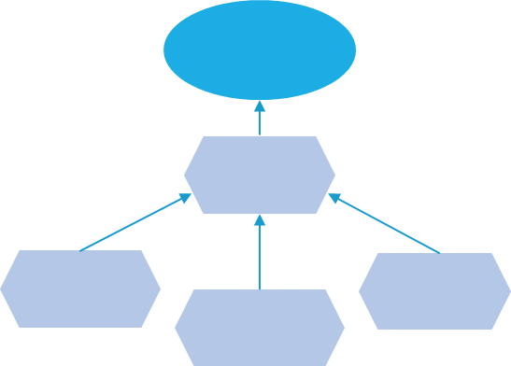
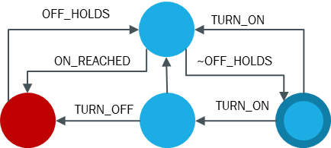


Overview
A. Innate Immunity Through Assurances
Design Process
System Model
Prototype Implementation
System Specification
System Prototype
Property Specification
System Properties
Observers
Operation Dataset
B. Adaptive Immunity Through Learning
Negative Selection
Pattern Analysis
Feature Engineering
Data Labeling
Data Processing
Non-Self
Detector Generator
Dataset
Self

Slide 12

Background

Slide 13
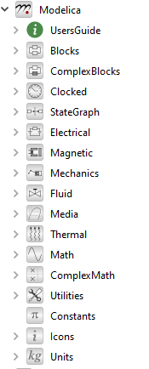
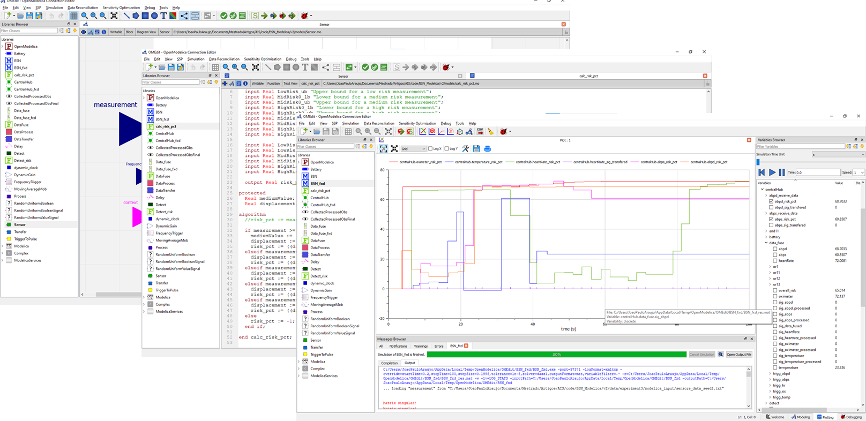


Modelica
Modelica is a mature industrial modeling language with multiple implementations, both proprietary and open source. Modelica aims to modeling and simulating cyber-physical systems, but it has also been used for automatically generating deployable (embedded) control software (C code) from models
Modelica is an acausal equation-based object-oriented modeling language for cyberphysical system modeling. In Modelica, behavior is described declaratively using mathematical equations and functions. Object-oriented concepts are used to encapsulate behavior and facilitate reuse of model components.
Modelica is superior to most other modeling formalisms due to the following important properties:
Object-oriented modeling
Acausal modeling: Modeling is based on equations instead of assignment statements as in traditional input/output block abstractions
Physical modeling of multiple domains : other techniques may require conversion to signal blocks
Hybrid modeling : Modeling of both discrete-time and continuous-time
Language for modeling CPS
Supports acausal connection of components governed by mathematical equations
Can be used conveniently for modeling complex systems containing
Mechanical, electrical, electronic, magnetic, hydraulic, thermal, control, electric power or process-oriented subcomponents
This makes it possible to capture the dynamic behavior of any physical domain
Behavior is described declaratively using mathematical equations and functions
Hybrid modeling : Modeling of both discrete-time and continuous-time

Slide 14
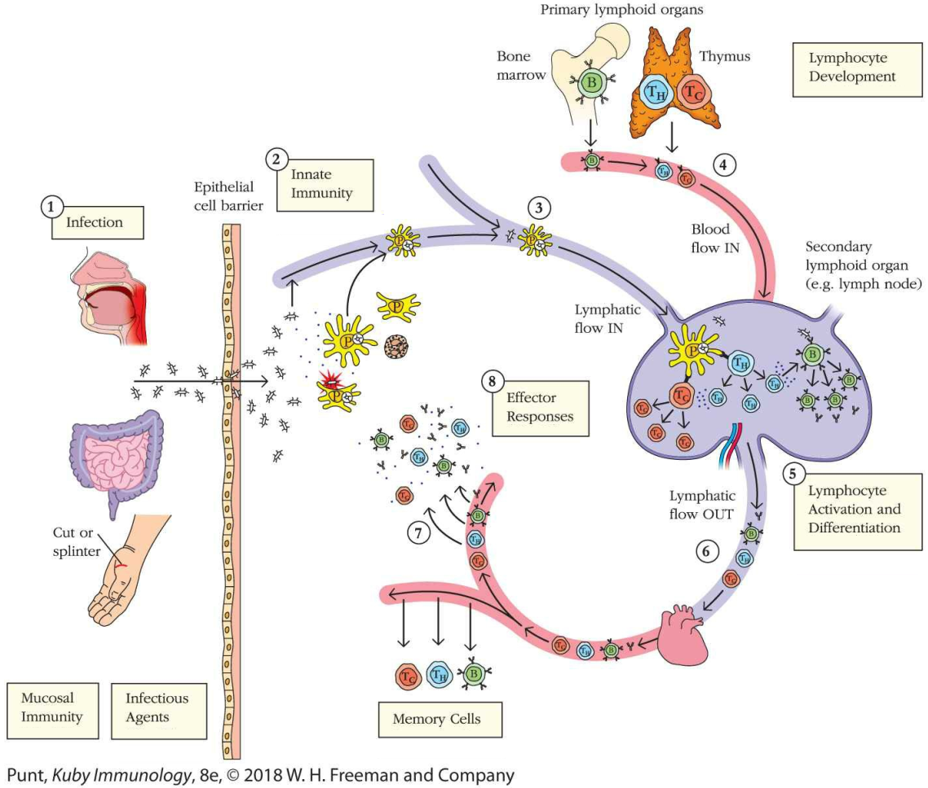
Negative selection process
Self/Nonself discrimination
Negative Selection Process
T-cells are matured in the Thymus
Receptors are differentiated by a pseudo-random genetic rearrangement process
Tested against self-cells
Bind?
Discard!
Did not Bind?
Seen as Nonself detector cell

Slide 15
Negative selection algorithm
Anomaly Detection
Negative Selection Algorithm
The goal is to identify the self-set counterpart
Performed by using some form of detector
Makes use of only the self-samples during the detector generation

Slide 16
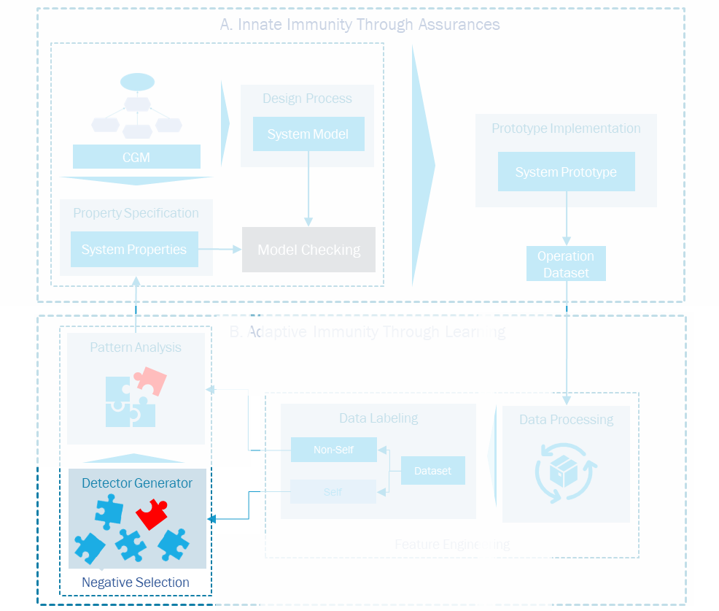

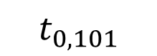
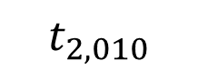
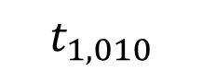
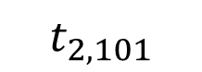


Negative selection algorithm
Self-set
0
1
1
1
1
1
1
0
1
0
0
0
1
1
1
0
1
0
0
1
Match?
No, accept!
$$t_{1, 010}$$
$$t_{2, 010}$$
0
1
0
0
0
1
1
1
$$t_{2, 101}$$
$$t_{0, 101}$$
1
0
1
*
0
1
0
*
Detectors
Candidate Detectors
Yes, discard!
$$t_{0, 010}$$
$$t_{1, 101}$$

Slide 17
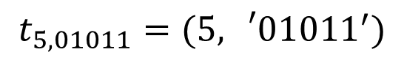
Negative selection algorithm
0
1
0
1
1
r = 5
1
1
0
1
0
0
1
0
1
1
0
0
0
1
1
String being compared
0
1
0
0
1
0
1
0
1
0
1
1
0
1
0
1
1
0
1
0
1
1
0
1
1
1
0
1
*
*
*
1
1
R-chunk
*
*
*
*
*
*
*
*
*
*
*
*
*
*
*
*
*
*
*
*
*
*
*
*
*
*
*
*
*
*
*
*
*
*
*
*
*
*
*
*
*
*
*
*
*
*
*
*
*
*
*
*
*
*
*
*
*
$$t_{5, 01011}=(5,{}_{}^{′}0{1011}^{′})$$

Slide 18



Running example: body sensor network

Slide 19
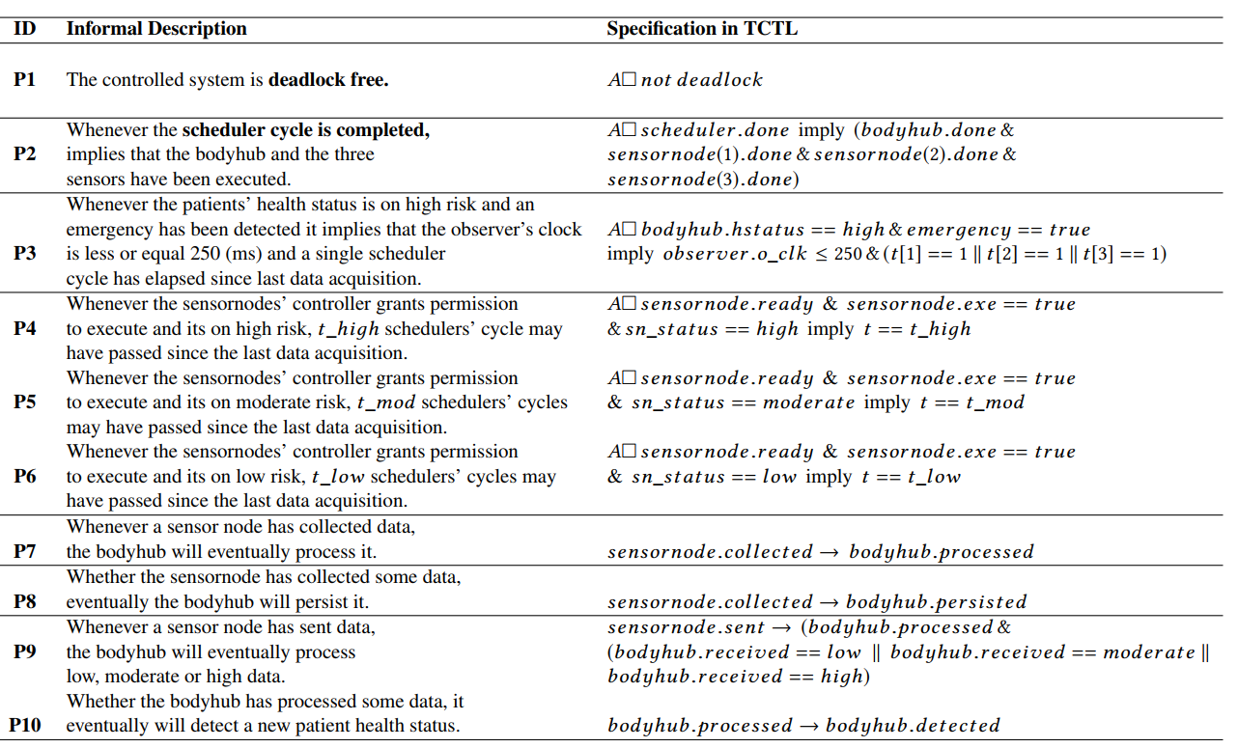
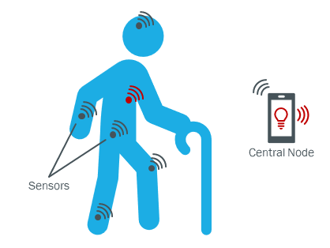
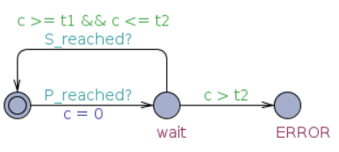
Body sensor network
P7
Whenever a sensor node has collected data, then, in 2 seconds, the central node will process it.
P7 observer template
Timed Response Globally pattern
BSN Properties
Thomas Vogel, Marc Carwehl, Genaína Nunes Rodrigues, Lars Grunske, A property specification pattern catalog for real-time system verification with UPPAAL, Information and Software Technology, Volume 154, 2023, 107100, ISSN 0950-5849,
Arthur Rodrigues, Ricardo D. Caldas, Genaína N. Rodrigues, Thomas Vogel, and Patrizio Pelliccione. 2018. A learning approach to enhance assurances for real-time self-adaptive systems. In Proc. SEAMS '18.ACM, NY, USA, 206–216.

Slide 20
Enhancing Property Specification of Cyber-Physical Systems using Negative Selection

Slide 21
Overview
A. Innate Immunity Through Assurances
Design Process
System Model
Prototype Implementation
System Specification
System Prototype
Property Specification
System Properties
Observers
Operation Dataset
B. Adaptive Immunity Through Learning
Negative Selection
Pattern Analysis
Feature Engineering
Data Labeling
Data Processing
Non-Self
Detector Generator
Dataset
Self

Slide 22
A. Innate Immunity Through Assurances
A. Innate Immunity Through Assurances
Design Process
System Model
Prototype Implementation
System Specification
System Prototype
Property Specification
System Properties
Observers
Operation Dataset
B. Adaptive Immunity Through Learning
Negative Selection
Pattern Analysis
Feature Engineering
Data Labeling
Data Processing
Non-Self
Detector Generator
Dataset
Self

Slide 23
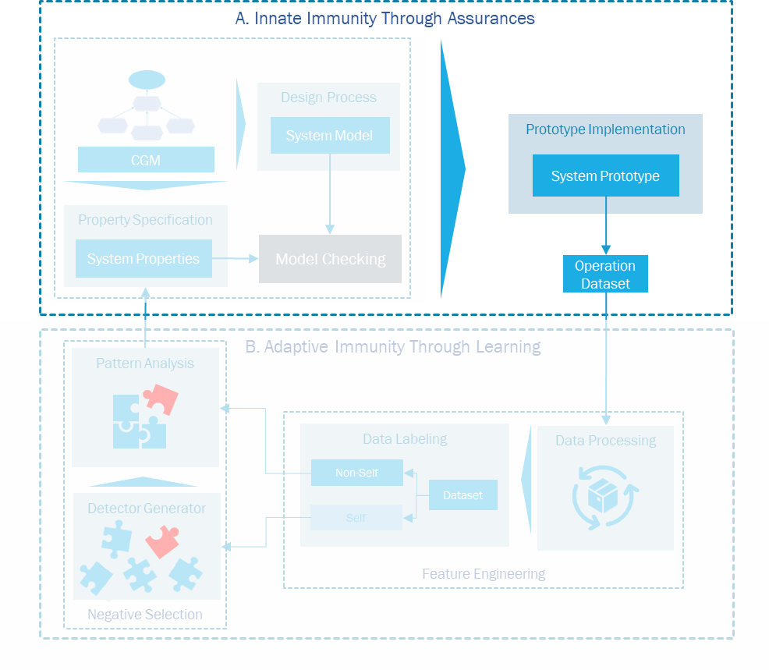
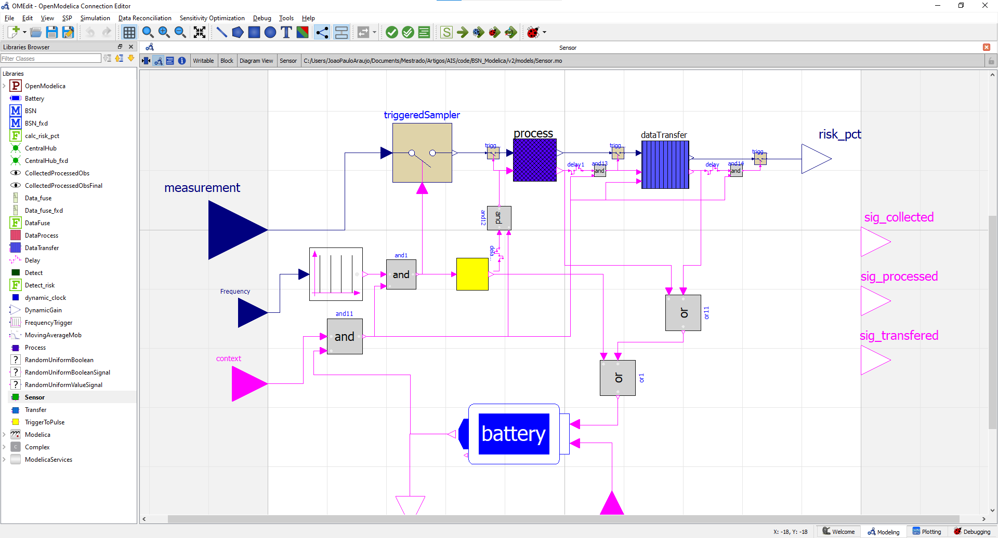
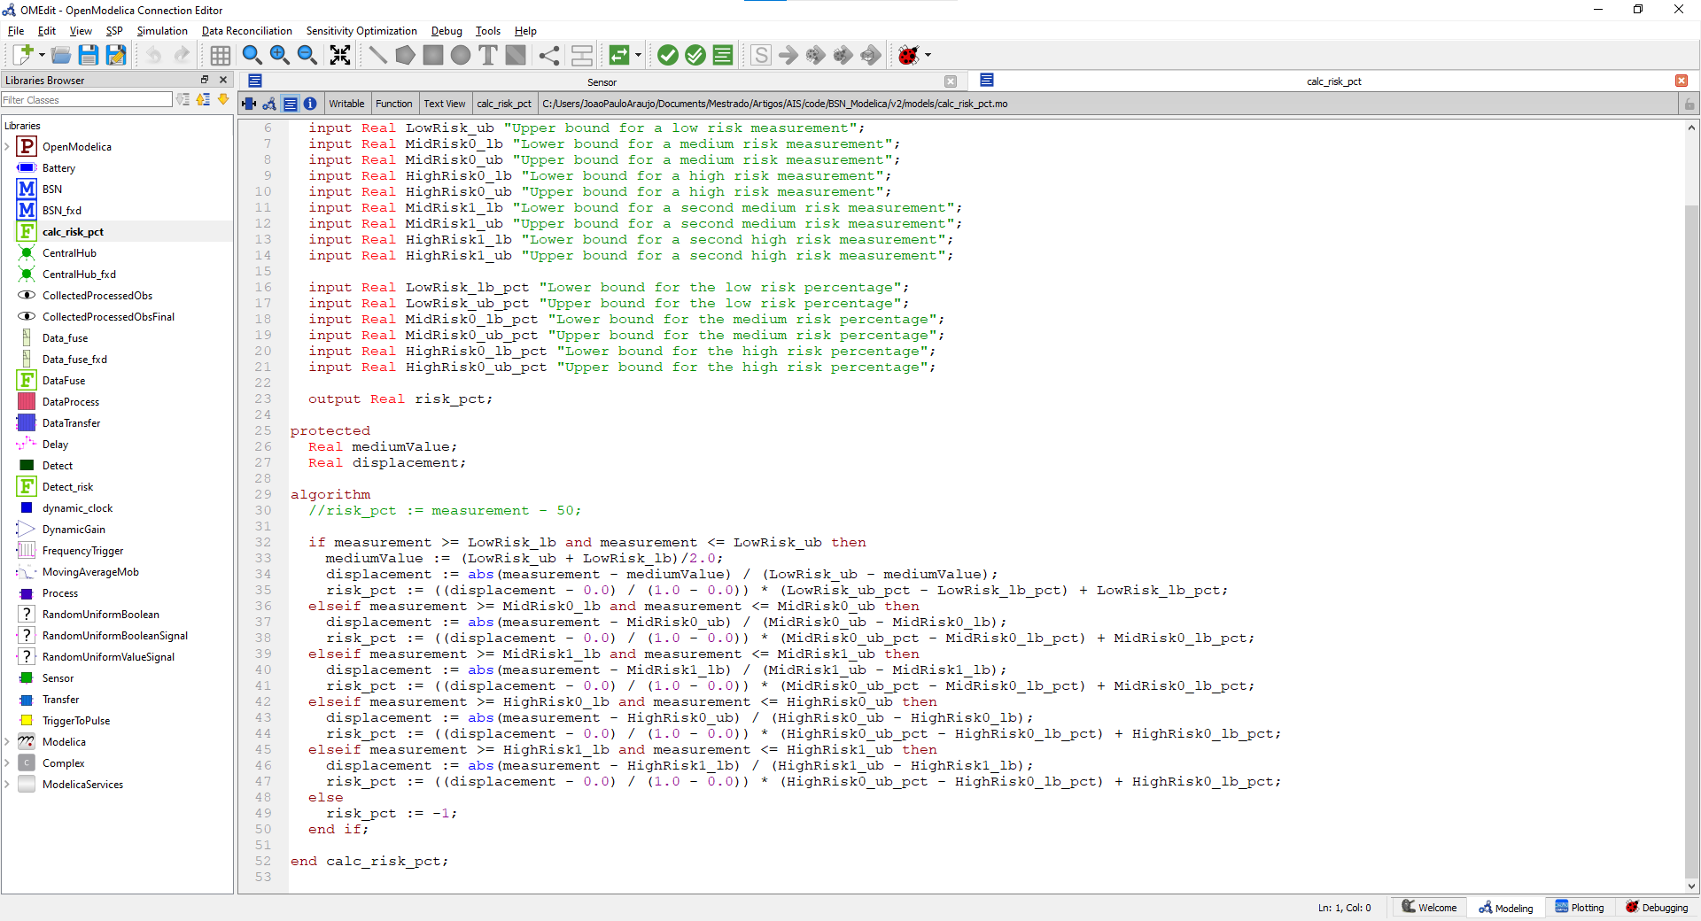
A. Innate Immunity Through Assurances - Prototype Implementation

Slide 24
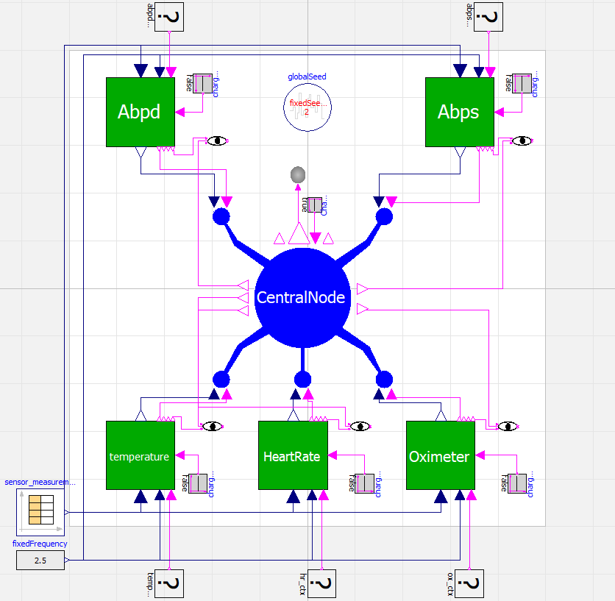
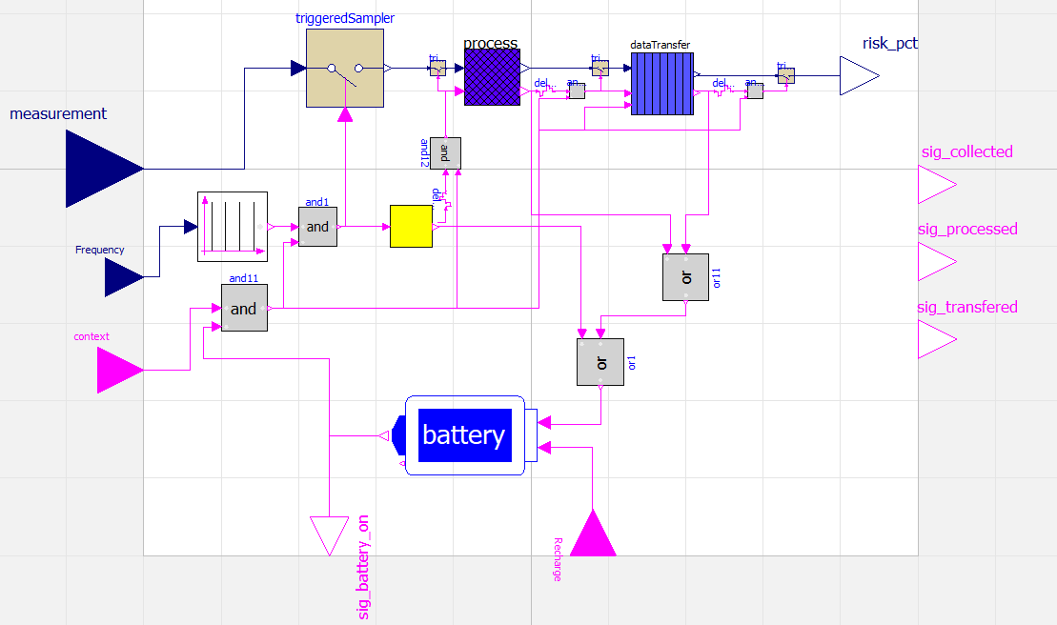
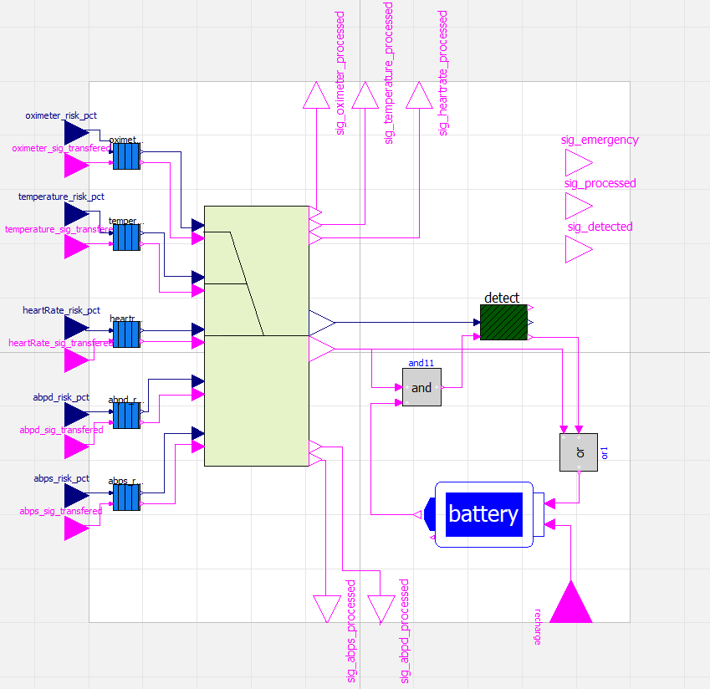
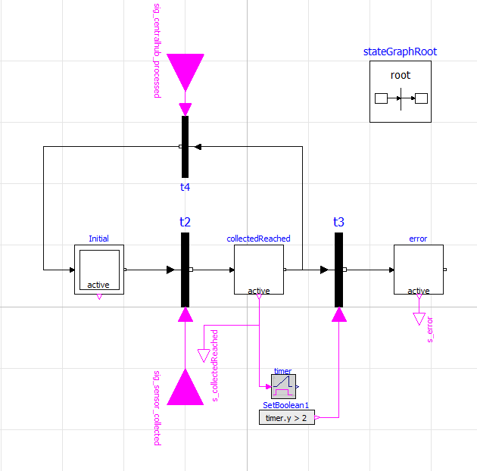
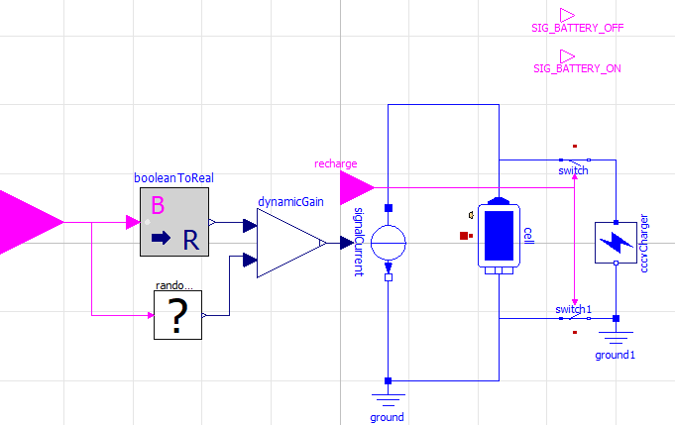
A. Innate Immunity Through Assurances - Prototype Implementation (BSN)
Sensor
P7 Observer
Central Node
BSN Prototype
Battery

Slide 25
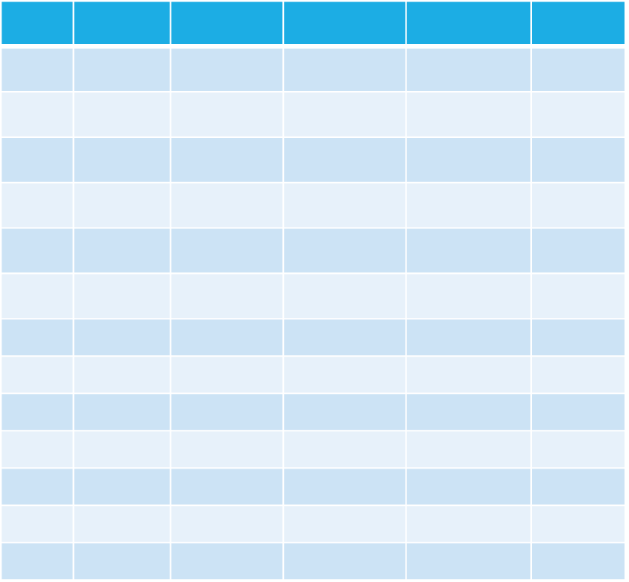
A. Innate Immunity Through Assurances – data extraction
Operation Dataset
BSN Prototype

Slide 26
B. Adaptive Immunity Through Learning
A. Innate Immunity Through Assurances
Design Process
System Model
Prototype Implementation
System Specification
System Prototype
Property Specification
System Properties
Observers
Operation Dataset
B. Adaptive Immunity Through Learning
Negative Selection
Pattern Analysis
Feature Engineering
Data Labeling
Data Processing
Non-Self
Detector Generator
Dataset
Self

Slide 27
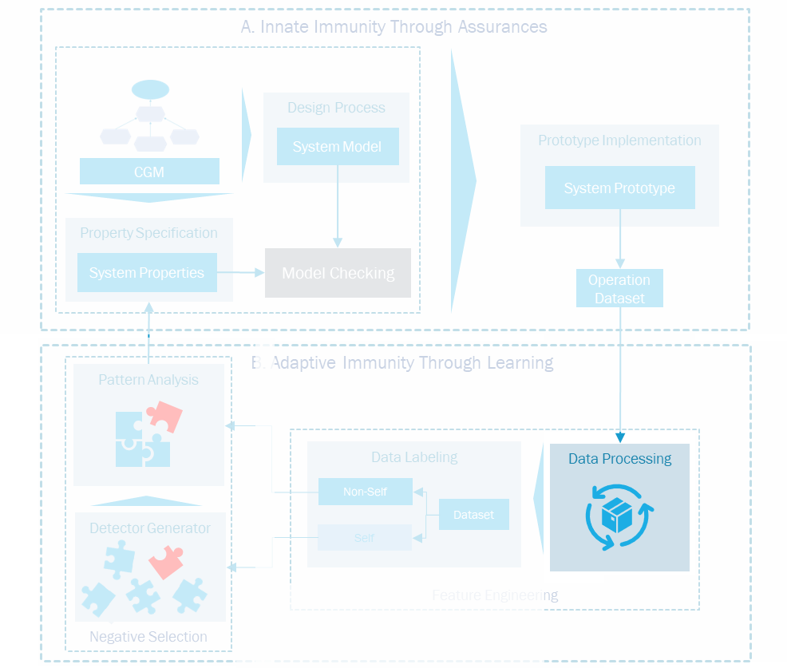
Data Processing
Time | Context | Collected | Processed | Transfered | Central_processed
0 | 1 | 0 | 0 | 0 | 0
0.5 | 1 | 1 | 0 | 0 | 0
1 | 1 | 0 | 1 | 0 | 0
1.5 | 1 | 0 | 0 | 0 | 0
2 | 0 | 0 | 0 | 1 | 0
2.5 | 1 | 0 | 0 | 0 | 1
3 | 1 | 0 | 0 | 0 | 0
3.5 | 1 | 1 | 0 | 0 | 0
4 | 0 | 0 | 0 | 0 | 0
4.5 | 1 | 0 | 1 | 0 | 0
5 | 1 | 0 | 0 | 0 | 0
5.5 | 1 | 0 | 0 | 0 | 1
6 | 1 | 1 | 0 | 0 | 0
0 | 1 | 0 | 0 | 0 | 0
P7
Whenever a sensor node has collected data, then the central node will process it.
Time restricted
T= 2s
Attribute Based
P7
Whenever a sensor node has collected data, then, in 2 seconds, the central node will process it.
3.5 | 1 | 1 | 0 | 0 | 0
4 | 0 | 0 | 0 | 0 | 0
4.5 | 1 | 0 | 1 | 0 | 0
5 | 1 | 0 | 0 | 0 | 0
5.5 | 1 | 0 | 0 | 0 | 1
6 | 1 | 1 | 0 | 0 | 0
Next Segment

Slide 28

Data Processing
Time | Context | Collected | Processed | Transfered | Central_processed
0 | 1 | 0 | 0 | 0 | 0
0.5 | 1 | 1 | 0 | 0 | 0
1 | 1 | 0 | 1 | 0 | 0
1.5 | 1 | 0 | 0 | 0 | 0
2 | 0 | 0 | 0 | 1 | 0
2.5 | 1 | 0 | 0 | 0 | 1
3 | 1 | 0 | 0 | 0 | 0
3.5 | 1 | 1 | 0 | 0 | 0
Features are generated based on the expert’s domain knowledge and represent the CPS’ behavior – Boolean preferably
Was it present at all times?
Segment Number | Sensor Collected | Sensor Processed | Sensor Transfered | Central node Processed | Context Always present | Time between process and transfer | Time until Central Node processed
1
1
1
1
1
0
0
0.5
null

Slide 29
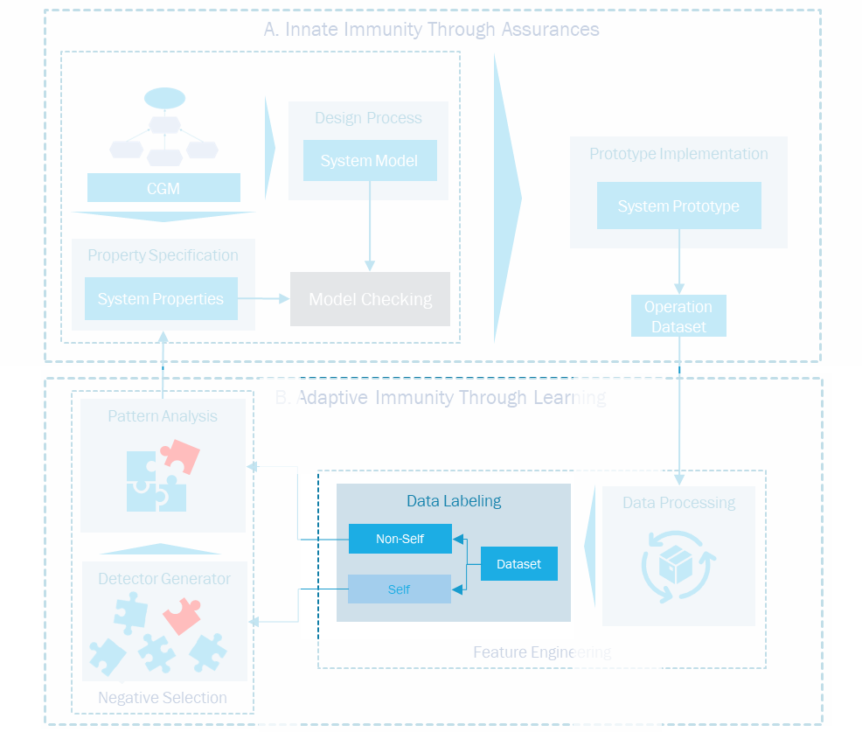
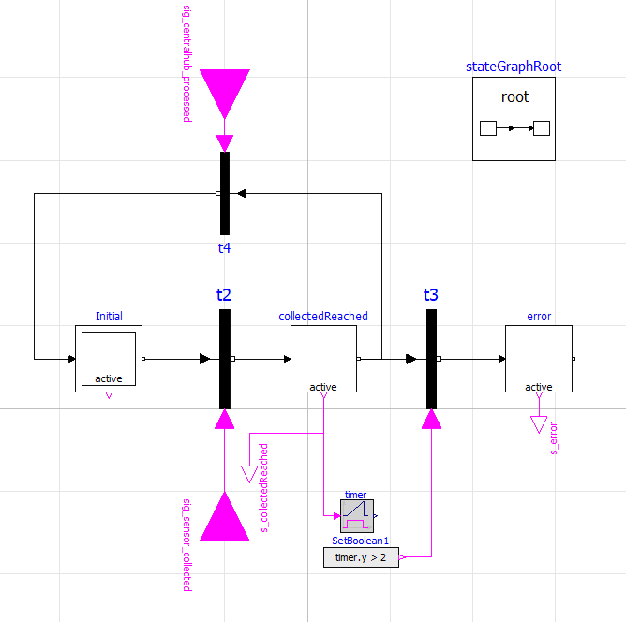
Data labeling
Central node Processed
Sensor Collected
Timer
Segment Number | Sensor Collected | Sensor Processed | Sensor Transfered | Central node Processed | Context Always present | Time between process and transfer | Time until Central Node processed
1
Label
1
1
1
1
0
0
0.5
null
1

Slide 30
Exploratory data analysis
Sanity Check
Feature Selection
Correlation
Missing Data
Context Always present
0.8465
Sensor Transfered
-0.6488
Data types
Sensor Collected
-0.5544
Central Node Processed
0.5312
Sensor Processed
0.3144
Threshold
Behavior
Emergency detected
0.1797
Central Node Persisted
-0.0655

Slide 31
String Formatting
Higher correlation
Context Always present | Transfered | Collected | Central Node processed | Processed
0 | 1 | 1 | 0 | 1
Label
1
0
1
1
0
1
Nonself

Slide 32
Detector Generation
Self-set
0
1
1
1
1
1
1
0
1
0
0
0
1
1
1
0
1
0
0
1
Match?
No, accept!
$$t_{1, 010}$$
$$t_{2, 010}$$
0
1
0
0
0
1
1
1
$$t_{2, 101}$$
$$t_{0, 101}$$
1
0
1
*
0
1
0
*
Detectors
Candidate Detectors
Yes, discard!
$$t_{0, 010}$$
$$t_{1, 101}$$

Slide 33
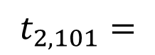
Pattern analysis
Why binary?
Simplicity
Interpretability
Position | Feature
0 | Context Always present
1 | Transfered
2 | Collected
3 | Central Node processed
4 | Processed
$$t_{2, 101}=$$
1
0
1

Slide 34

Evaluation

Slide 35
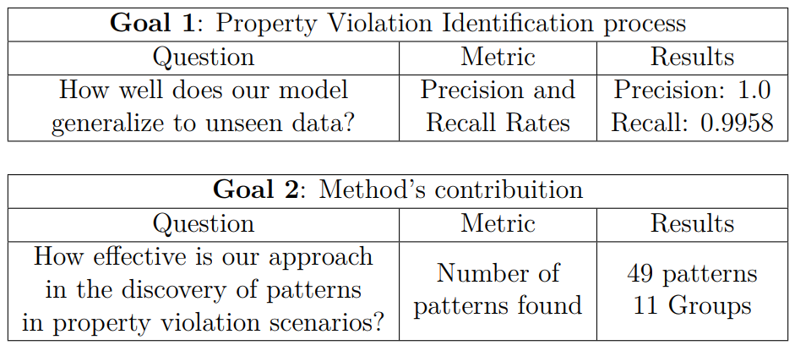
Evaluation

Slide 36



Experiment setup
Intel(R) Core(TM) i5-10210U,
2.10 GHz, 16GB
v3.9
v4.0.0
v1.19.2

Slide 37
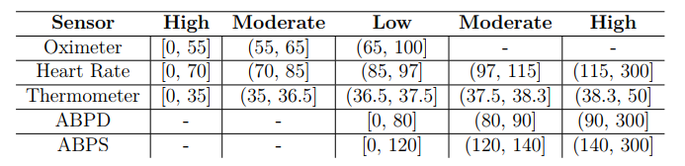
Experiment setup – Input Data Generation
Sensor 1
Increase
Stable
Sensor 2
1,000
Profiles Generated
Patient Profile 1
Decrease
...
Ranges of the Sensors
Sensor 5

Slide 38
Experiment setup – Simulation
1,000
Profiles Generated
Operation Dataset

Slide 39
feature engineering
Feature Engineering
Data Processing
Data Labeling
Non-Self
Dataset
Self
Operation Dataset

Slide 40

Experiment setup – selected Features
16,493
(83%)
19,868
Execution Segments
Self
3,375
(17%)
Non-Self
Self-Nonself proportion

Slide 41
Experiment setup – selected Features
Position | Feature | Phi-Correlation (Abs)
0 | Oximeter was available during data transfer | 0.927324
1 | Oximeter transferred data | 0.923101
2 | Oximeter was available during Central Node data processing | 0.849276
3 | Oximeter Battery became unavailable during trace | 0.508921
4 | Oximeter became unavailable during trace | 0.462366
5 | Oximeter battery became unavailable during data collection | 0.300302
6 | Oximeter processed data | 0.300302
7 | Oximeter battery became unavailable during data processing | 0.296026
8 | Oximeter became unavailable during data transfer | 0.269047
9 | ABPD battery became unavailable during trace | 0.136670
10 | ABPS battery became unavailable during trace | 0.133274
11 | Heart Rate battery became unavailable during trace | 0.129930
12 | Thermometer battery became unavailable during trace | 0.126224
Selected Features

Slide 42
Evaluation

Slide 43
Train-test split
Stratified Randomized Split
Dataset
Train (75%)
Test (25%)
Nonself
Self
Test
How does the model generalize?
Property Violations
Regular Execution

Slide 44
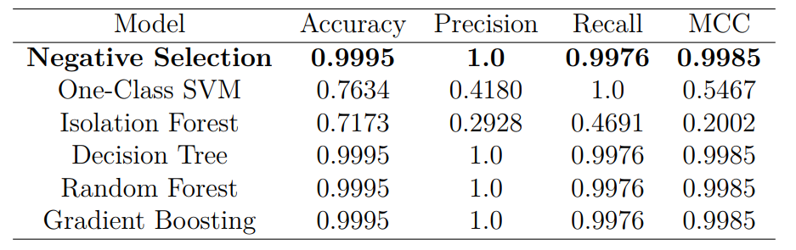
Goal 1 – NSA evaluation
True Negative
4123
False Positive
0
False Negative
2
True Positive
842
Model Comparison
NSA Confusion Matrix

Slide 45
Evaluation

Slide 46
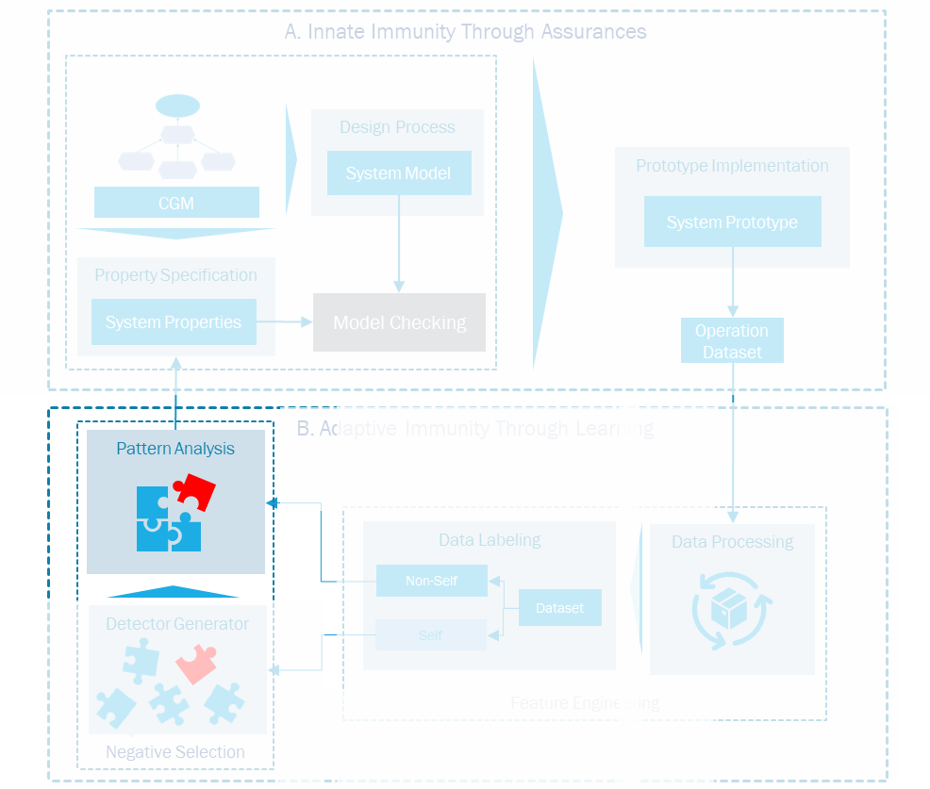
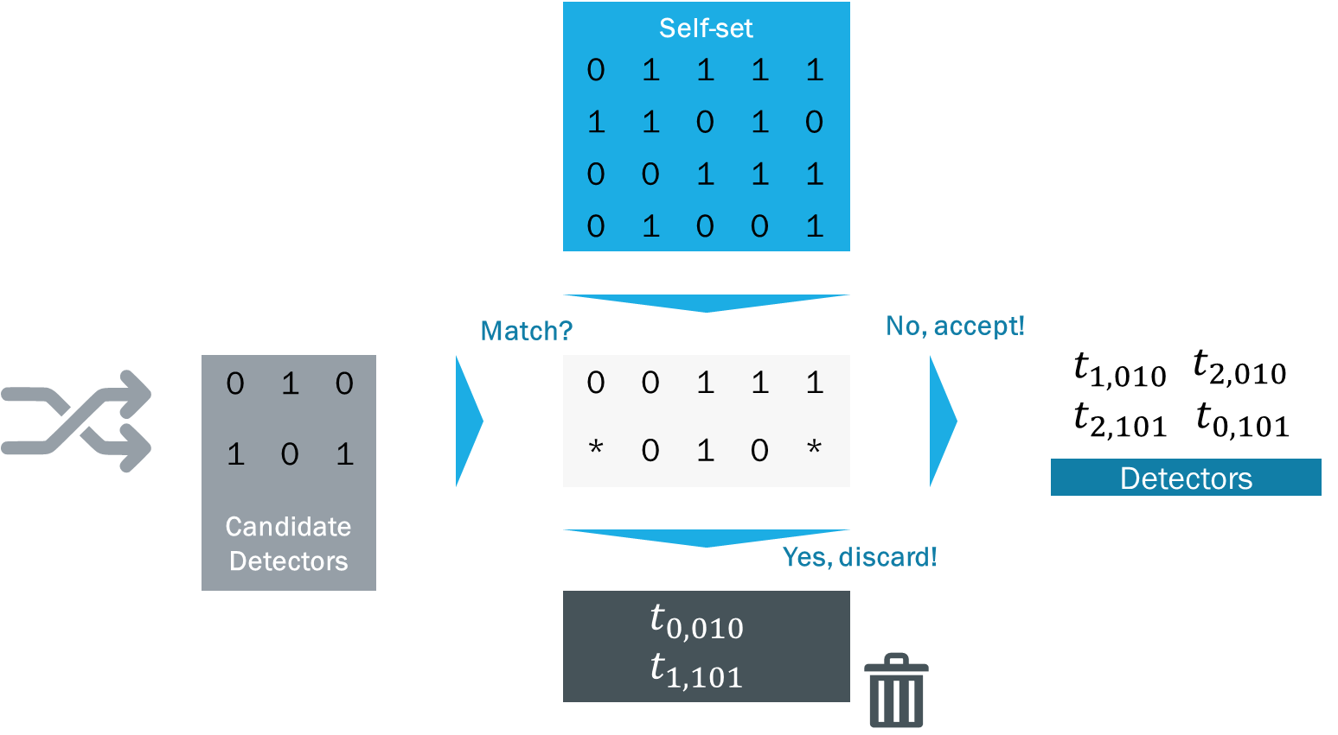
Goal 2 – Generated Detectors
229
Detectors Generated
68
Detectors Matched Nonself
229
Detectors Generated

Slide 47
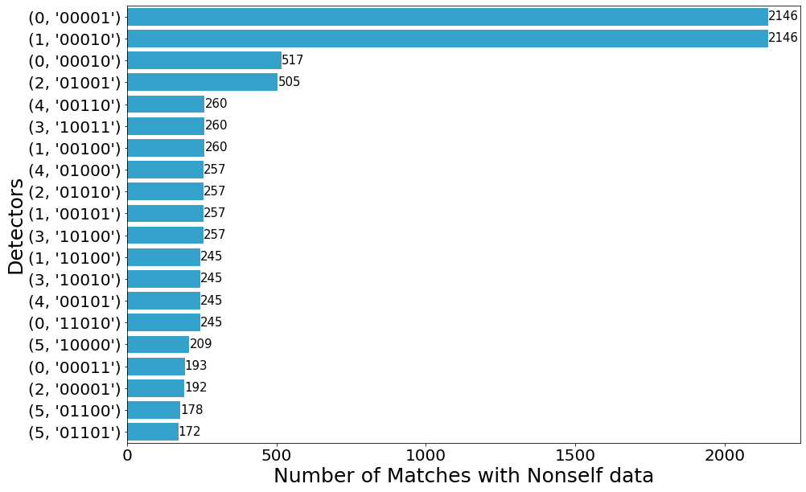
Goal 2 - Agglutination
Matches by Detector (Top 20)
229
Detectors Generated
(1, ‘00010’)
(0, ‘000010’)
68
Detectors Matched Nonself
(0, ‘00001’)
49
Detectors after Agglutination

Slide 48
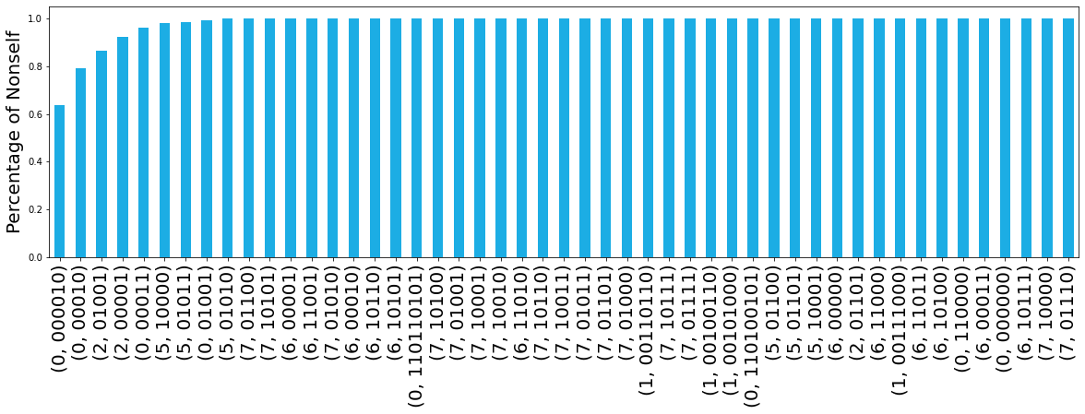
Goal 2 - coverage
Detector Coverage
100%

Slide 49
Goal 2 – Groups of patterns
Shared Pattern
(0, ‘00011’)
(1, ‘00110110’)
(1, ‘00111000’)
(1, ‘00110110’)
(1, ‘00111000’)
(0, ‘00011’)
Specialization 1
Specialization 2

Slide 50
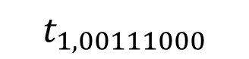
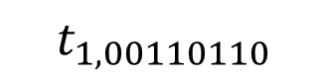
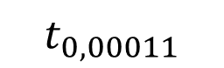
Goal 2 – Groups of patterns
$$t_{0, 00011}$$
$$t_{1, 00110110}$$
$$t_{1, 00111000}$$
Position | Feature
0 | Oximeter was available during data transfer
1 | Oximeter transfered data
2 | Oximeter was available during Central Node data processing
3 | Oximeter Battery became unavailable during trace
4 | Oximeter became unavailable during trace
5 | Oximeter battery became unavailable during data collection
6 | Oximeter processed data
7 | Oximeter battery became unavailable during data processing
8 | Oximeter became unavailable during data transfer
0
Shared Pattern
0
0
0
0
0
0
1
1
1
1
1
1
0
1
Specialization 1
Specialization 2
1
0
1
0
0
0

Slide 51
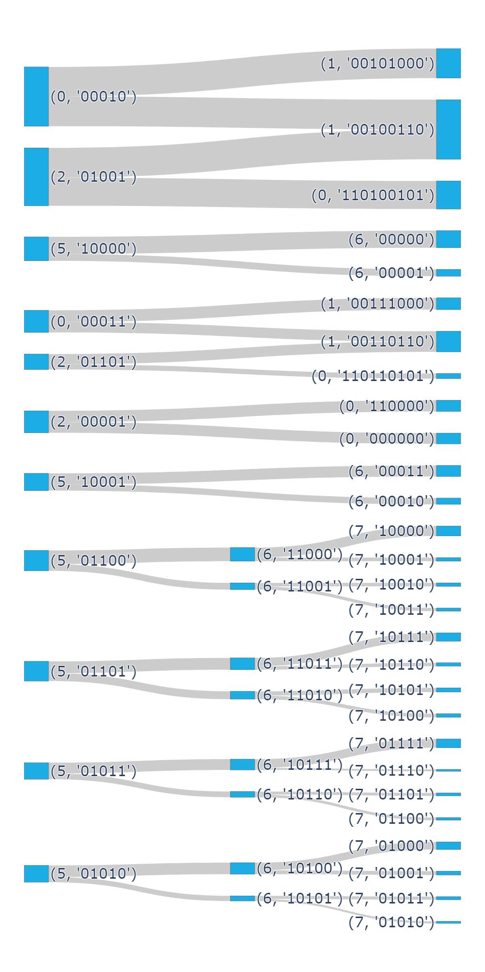

Goal 2 – Groups of patterns
Group 2
G
Group 1
H
A
B
I
C
J
D
K
E
F
(0, '000010')
(0, '01001')

Slide 52
Goal 2 - Groups of patterns
229 Detectors Generated
68 Detectors Matched Nonself
49 Detectors After agglutination
11 Groups of Detectors

Slide 53
Goal 2 – Groups of patterns (Group 1)
Group | Detectors | Description | % Matched
A | (0, ’00010’) (1,’00101000’) | Lack of battery during data collection | 7,61%
1 | (0, ’00010’) (1,’00100110’) (2,’01001’) | Lack of battery during data processing | 7,70%
2 | (2,’01001’) (0,’110100101’) | Lack of battery during data transferring | 7,26%
B | (5,’100000’) (6,’00000’) | Lack of battery during data collection | 4,41%
4 | (5,’100000’) (6,’00001’) |  | 1,78%
C | (0,’00011’) (1,’00111000’) | Lack of battery during data collection | 3,05%
6 | (0,’00011’) (1,00110110’) (2,’01101’) | Lack of battery during data processing | 2,67%
7 | (2,’01101’) (0,’110110101’) | Sensor absent during transfer | 1,33%
D | (2,’00001’) (0,’110000’) | Sensor absent during Central Node processing | 2,90%
 | (2,’00001’) (0,’000000’) |  | 2,79%
E | (0,’000010’) | Sensor absent at some point | 63,59%
F | (0,’01001’) | Sensor absent during Central Node processing | 0,68%
Leftmost bits
Possible Failure Causes
Lack of Battery
Sensor Absent
The sensor’s battery plays a key role in the property violation
Sensor Absent was already considered in the specification
(Not a novelty)

Slide 54
Goal 2 – Groups of patterns (Group 2)
Group | Detectors | Description | % Matched
G | (5,’10001’) (6,’00011’) | Lack of battery during data collection | 2,84%
 | (5,’10001’) (6,’00010’) |  | 1,63%
H | (5,’01100’) (6,’11000’) (7,’10000’) | Lack of battery during data processing | 2,58%
 | (5,’01100’) (6,’11000’) (7,’10001’) |  | 0,95%
 | (5,’01100’) (6,’11001’) (7,’10010’) |  | 0,92%
 | (5,’01100’) (6,’11001’) (7,’10011’) |  | 0,83%
I | (5,’01101’) (6,’11011’) (7,’10111’) | Lack of battery during data processing | 2,16%
 | (5,’01101’) (6,’11011’) (7,’10110’) |  | 0,89%
 | (5,’01101’) (6,’11010’) (7,’10101’) |  | 1,10%
 | (5,’01101’) (6,’11010’) (7,’10100’) |  | 0,95%
J | (5,’01011’) (6,’10111’) (7,’01111’) | Lack of battery during data transferring | 2,28%
 | (5,’01011’) (6,’10111’) (7,’01110’) |  | 0,50%
 | (5,’01011’) (6,’10110’) (7,’01101’) |  | 0,77%
 | (5,’01011’) (6,’10110’) (7,’01100’) |  | 0,71%
K | (5,’01010’) (6,’10100’) (7,’01000’) | Lack of battery during data transferring | 1,99%
 | (5,’01010’) (6,’10100’) (7,’01001’) |  | 1,01%
 | (5,’01010’) (6,’10101’) (7,’01011’) |  | 0,80%
 | (5,’01010’) (6,’10101’) (7,’01010’) |  | 0,53%
Noise
Rightmost bits
Changes happen mainly in the lower bits
Other sensor’s batteries (Noise)
Low percentages
Same patterns from previous groups
The patterns here are related to the least important features, which ended up adding noise to the analysis

Slide 55
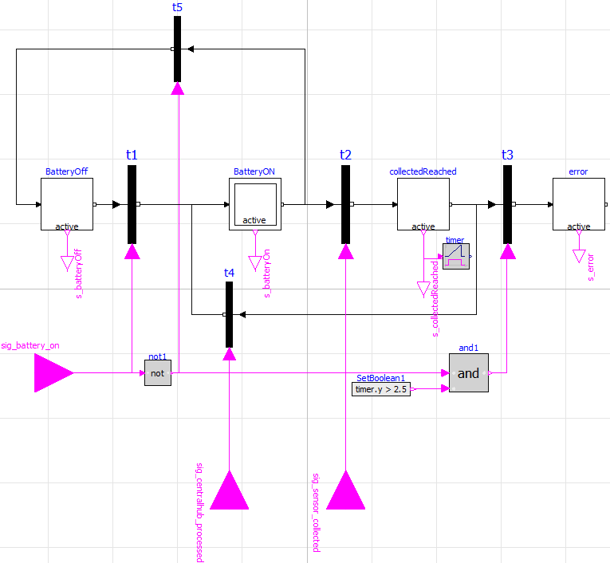
Goal 2 – Observer Enhancement
The sensor’s battery plays a key role in the property violation

Slide 56
Goal 2 – comparison (DT)
Oximeter was available during data transfer
Feature | Pattern 1 | Pattern 2 | Pattern 3
Oximeter was available during data transfer | False | True | True
Oximeter Battery became unavailable during trace |  | True | False
Oximeter was available during Central Node data processing |  |  | False
Oximeter became unavailable during trace |  |  | False
False
True
Violation
Oximeter Battery became unavailable during trace
False
True
Oximeter was available during Central Node data processing
Violation
False
True
Oximeter became unavailable during trace
Regular
Relevant Patterns
False
True
Violation
Thermometer battery became unavailable during trace
Noise
False
True
Heart Rate battery became unavailable during trace
ABPD battery became unavailable during trace
False
True
False
True
ABPS battery became unavailable during trace
ABPS battery became unavailable during trace
Regular
Heart Rate battery became unavailable during trace
False
True
False
True
False
True
ABPD battery became unavailable during trace
Regular
ABPD battery became unavailable during trace
ABPD battery became unavailable during trace
ABPS battery became unavailable during trace
ABPS battery became unavailable during trace
False
True
False
True
False
True
False
True
False
True
Regular
Regular
Regular
Regular
Regular
Regular
Regular
Regular
Regular
Regular

Slide 57
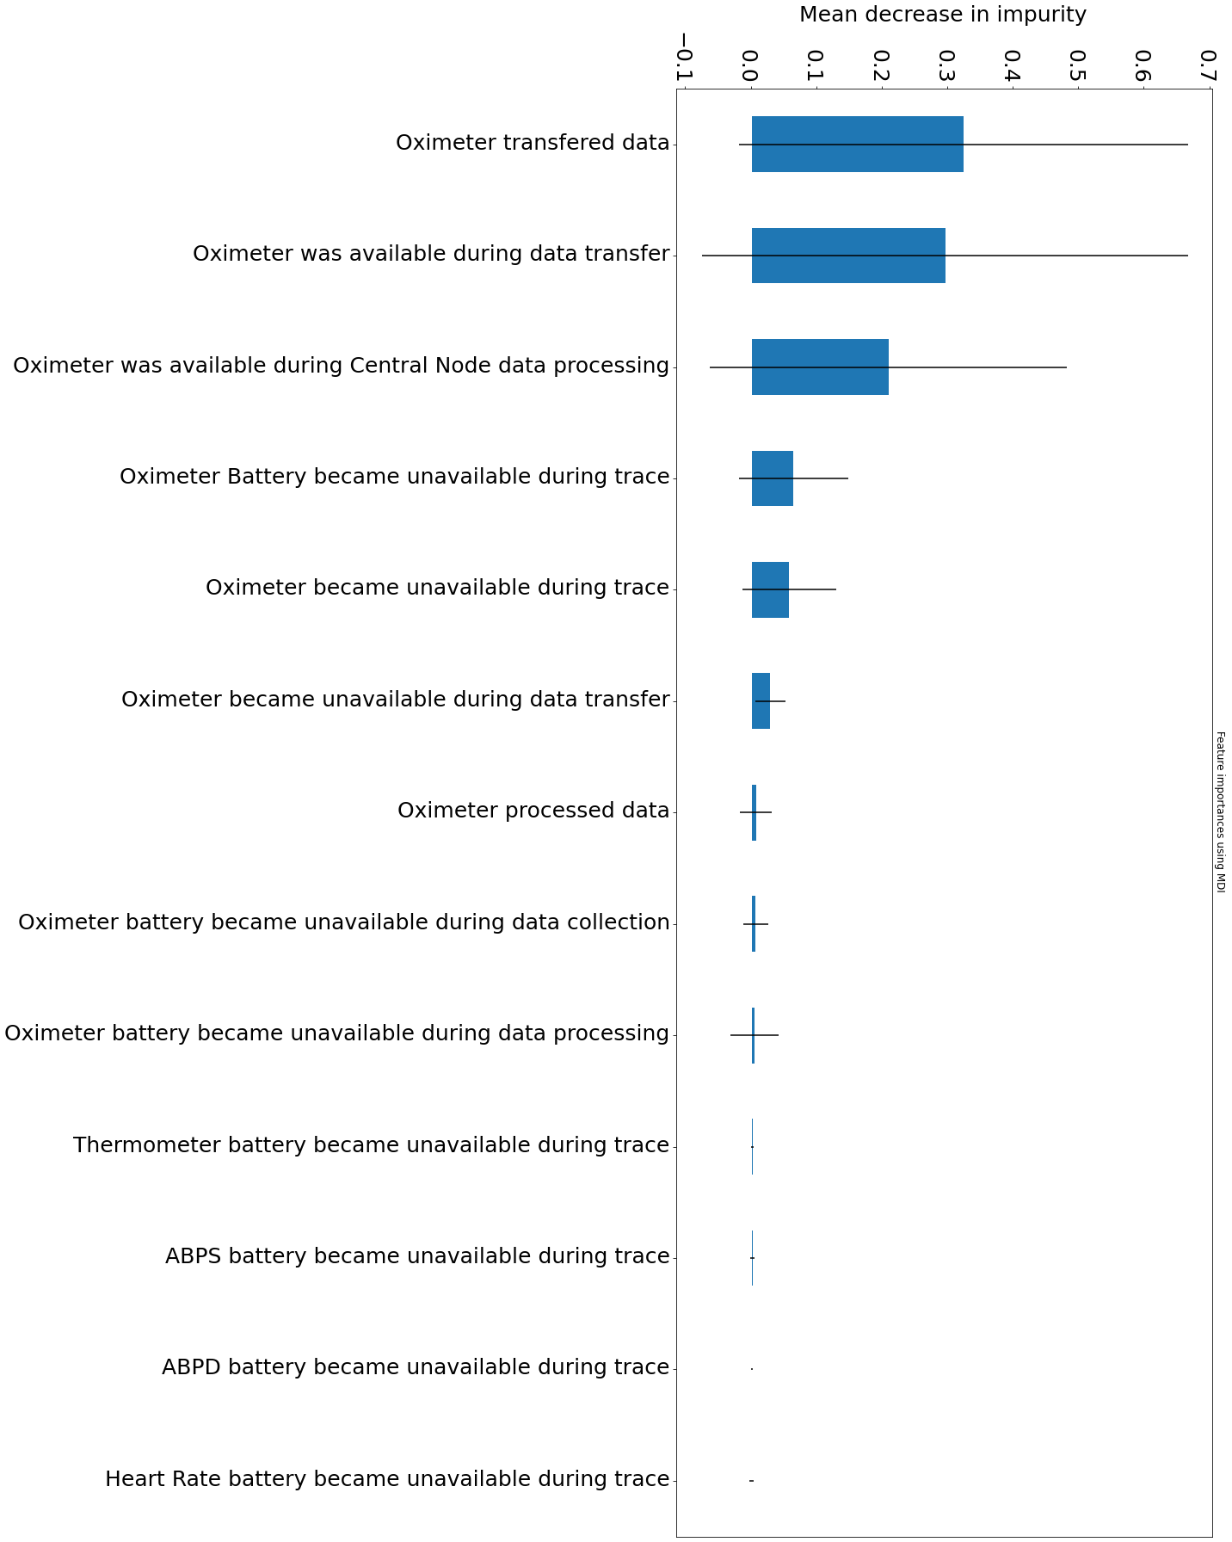
Goal 2 – Comparison (random forest)
Position | Feature | Phi-Correlation (Abs)
0 | Oximeter was available during data transfer | 0.927324
1 | Oximeter transferred data | 0.923101
2 | Oximeter was available during Central Node data processing | 0.849276
3 | Oximeter Battery became unavailable during trace | 0.508921
4 | Oximeter became unavailable during trace | 0.462366
5 | Oximeter battery became unavailable during data collection | 0.300302
6 | Oximeter processed data | 0.300302
7 | Oximeter battery became unavailable during data processing | 0.296026
8 | Oximeter became unavailable during data transfer | 0.269047
9 | ABPD battery became unavailable during trace | 0.136670
10 | ABPS battery became unavailable during trace | 0.133274
11 | Heart Rate battery became unavailable during trace | 0.129930
12 | Thermometer battery became unavailable during trace | 0.126224

Slide 58

Related work

Slide 59
Related work
Work by | CPS | Simulation | Design-time (DT)/ Runtime Verification (RT) | Fault Detection | Fault Diagnosis | NSA | Unanticipated Violations | Techniques Applied
Akella et al. (2006) | ✔ | ✔ | ✔ (DT) |  |  |  |  | Simplification of the physical processes;
Botaschanjan et al. (2008) | ✔ | ✔ | ✔ (DT) |  |  |  |  | Verification of lower layers; simulation of upper layers
Webster (2014) | ✔ | ✔ | ✔ (DT) |  |  |  |  | Formal methods; Simulation
Jones et al. (2014) |  |  | ✔ (RT) | ✔ |  |  |  | Data Generation based on STL Properties; One-class SVM; Focus on cybersecurity
Zhang et al. (2013) | ✔ |  | ✔ (RT) | ✔ | ✔ |  |  | Model-based simulation with fault-tolerant mechanisms
Poon et al. (2016) | ✔ | ✔ | ✔ (RT) | ✔ | ✔ |  |  | Model-based; switched linear state estimator for FDI; predefined fault diagnosis
Garcia et al. (2022) | ✔ |  | ✔ (RT) | ✔ | ✔ |  |  | Real-time monitoring; fault diagnosis using Voc-Isc curve analysis
Chopdar and Koshti (2022) | ✔ | ✔ | ✔ (RT) | ✔ | ✔ |  |  | Artificial Neural Networks for fault detection and classification; Data simulated with Simulink
Govender and Mensah (2010) | ✔ | ✔ | ✔ (RT) | ✔ |  | ✔ |  | Simulation using Matlab; Binary Negative Selection
Alizadeh et al. (2017) | ✔ |  | ✔ (RT) | ✔ | ✔ | ✔ |  | V-detectors; Instances of NSA for predefined fault diagnosis
Ren et al. (2020) | ✔ | ✔ | ✔ (RT) | ✔ | ✔ | ✔ |  | V-detectors; predefined fault representatives
Present work | ✔ | ✔ | ✔ (RT) | ✔ | ✔ | ✔ | ✔ | Model-based simulation; Runtime monitors; Binary NSA

Slide 60
Threats to validity
Bias in the generated patient profiles?
Was the prototype accurate?
Binary NSA well-known issues
Generate-and-test is very time consuming
Existence of “holes”
Only works for stable definitions of self

Slide 61


conclusion

Slide 62
Conclusion and future work
A. Innate Immunity Through Assurances
Methodology to systematically enhance the verification task
performed by runtime monitors in Cyber-physical systems
Design Process
System Model
Prototype Implementation
System Specification
System Prototype
Prototype of the CPS
Property Specification
NSA for unveiling patterns in property violation scenarios
System Properties
Observers
Operation Dataset
B. Adaptive Immunity Through Learning
Future Work
Negative Selection
Pattern Analysis
Feature Engineering
Application in different domains
Data Labeling
Data Processing
Non-Self
Causality analysis
Detector Generator
Dataset
Self
Usage of more advanced versions of the NSA

